Slide 1
Probability and Statistics
Textbook Appendix
BIO 594
Jon Puritz

Slide 2
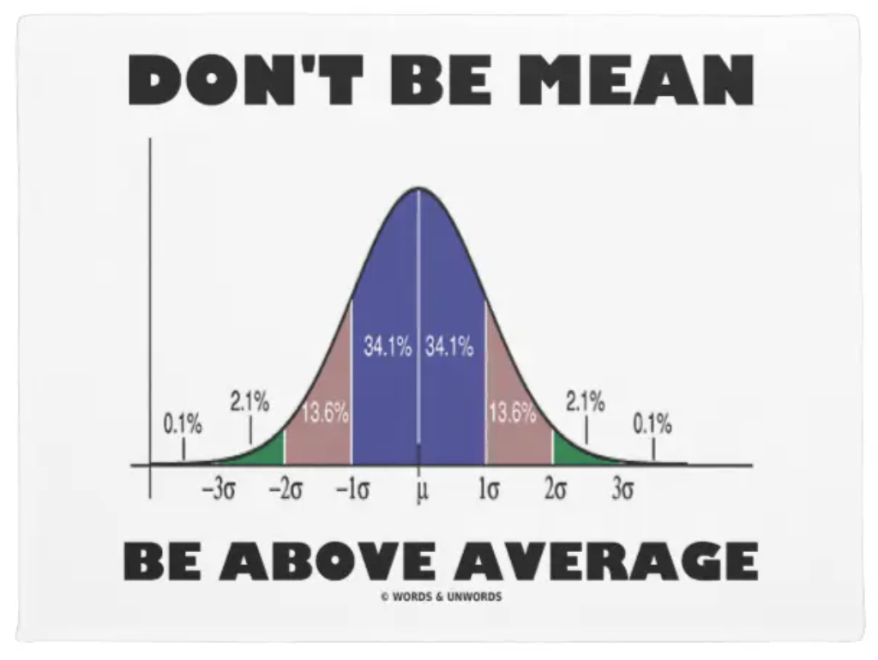
Outline
Statistical Paradigm Overview
Probability
Statistical measures and tests
Frequentist hypothesis testing, statistical errors, and power
Parameter estimation, accuracy, and precision
Likelihood statistics
Bayesian statistics

Slide 3
Motivational quote
He has a lot of extremely abstruse, in fact almost esoteric mathematics. Mathematics, incidentally, of a kind which I certainly do not claim to understand. I am not a mathematician at all. My way of reading Sewall Wright’s papers, which I think is perfectly defensible, is to examine the biological assumptions the man is making, and to read the conclusions he arrives at, and hope to goodness that what comes in between is correct.
Theodosius Dobzhansky

Slide 4
Statistical Paradigm Overview
Let’s define these two terms first:
Parameter
Statistic

Slide 5
Frequentist Approach
Stating a hypothesis
Collecting data
Computing a summary statistic
Test hypothesis

Slide 6
Frequentist Approach
Stating a hypothesis
Collecting data
Computing a summary statistic
Test hypothesis
Test/infer how frequently we would observe our data by chance alone if the NULL hypothesis was true

Slide 7
Probability
The probability (P) of an event is the number of times the event will occur (a) divided by the total number of possible events (n):
P = a/n
The product rule states that the probability of two or more independent events occurring simultaneously is equal to the product of their individual probabilities.
The sum rule states that the probability of two or more mutually exclusive events occurring is equal to the sum of their individual probabilities

Slide 8

Product Rule
The product rule states that the probability of two or more independent events occurring simultaneously is equal to the product of their individual probabilities.
$ρ\left(X,Y\right)= ρ\left(Y\right|X)ρ(X)$

Slide 9

Sum Rule
The sum rule states that the probability of two or more mutually exclusive events occurring is equal to the sum of their individual probabilities
$ρ\left(X\right)= \sum_{Y}{ρ(X,Y)}$

Slide 10

Conditional Probability
A conditional probability is the probability of an event given that another event has happened
Conditional probabilities are used whenever considering events that are not independent.
$P\left(E_{2} | E_{1}\right)= \frac{P\left(E_{1}\&E_{2}\right)}{P\left(E_{1}\right)}$

Slide 11
Statistical Measures and distributions
A statistic is a single measure of an attribute of a sample (e.g., its arithmetic mean value).
A statistic is computed from a sample because the entire population usually cannot be collected or measured.
Types
Descriptive Statistics
Means, medians
Tests of differences
Parametric
Require statistical distribution for tests of significance
Nonparametric
Tested via ranks and randomization

Slide 12
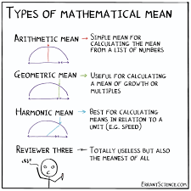

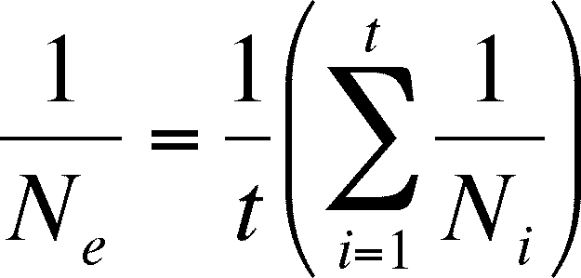

Statistical Measures and distributions
Means
Arithmetic mean
Harmonic mean
Geometric mean

Slide 13
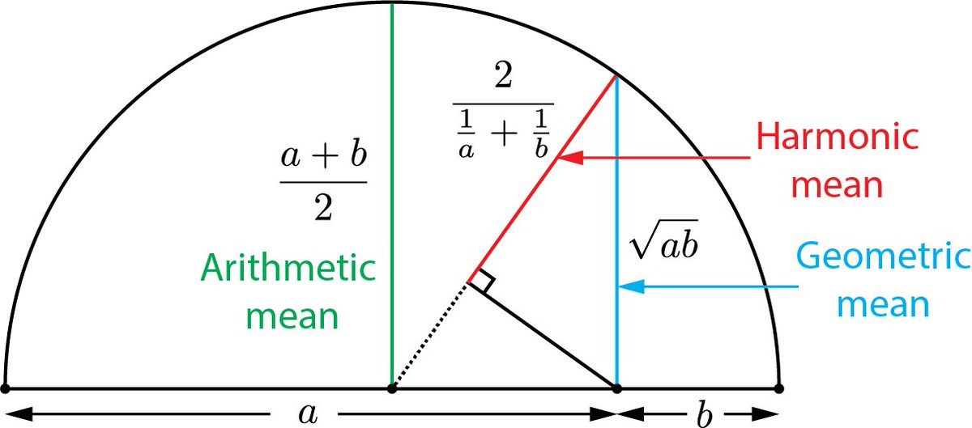
Statistical Measures and distributions

Slide 14
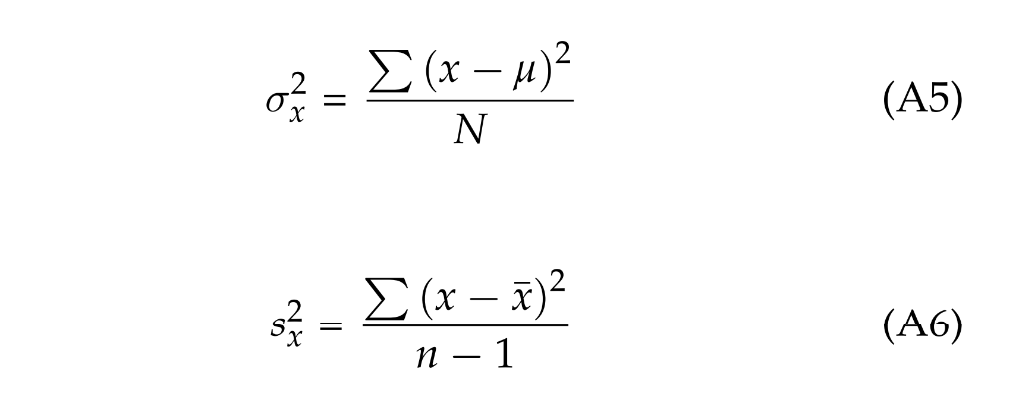

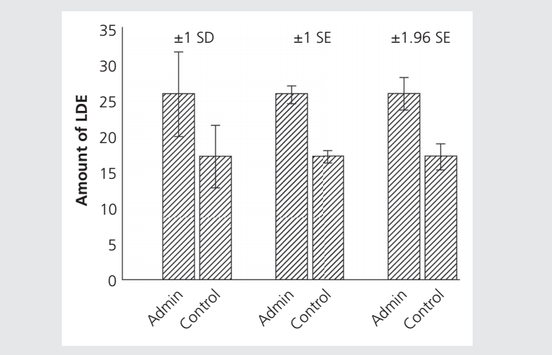
Statistical Measures and distributions
Variation
Sample variance
Standard deviation
Square root of the variance
Standard Error
Standard deviation divided by n

Slide 15
Frequentist Approach
Stating a hypothesis
Collecting data
Computing a summary statistic
Test hypothesis
Test/infer how frequently we would observe our data by chance alone if the NULL hypothesis was true

Slide 16
Probability Distributions
Probability distributions are needed for statistical tests and estimators
Different types of variables and statistics have different probability distributions

Slide 17

Probability Distributions
Binomial
$$P_{x}= \left({n \atop x}\right)p^{x}q^{n−x}= \frac{n!}{\left(n−x\right)!x!}p^{x}q^{n−x}$$
n = the number of trials
x = the number of successes
p = probability of getting a success in one trial
q = 1- p = the probability of getting a failure in one trial

Slide 18
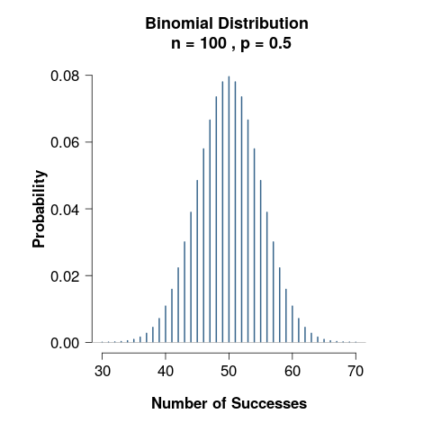
Probability Distributions
https://shiny.rit.albany.edu/stat/binomial/

Slide 19
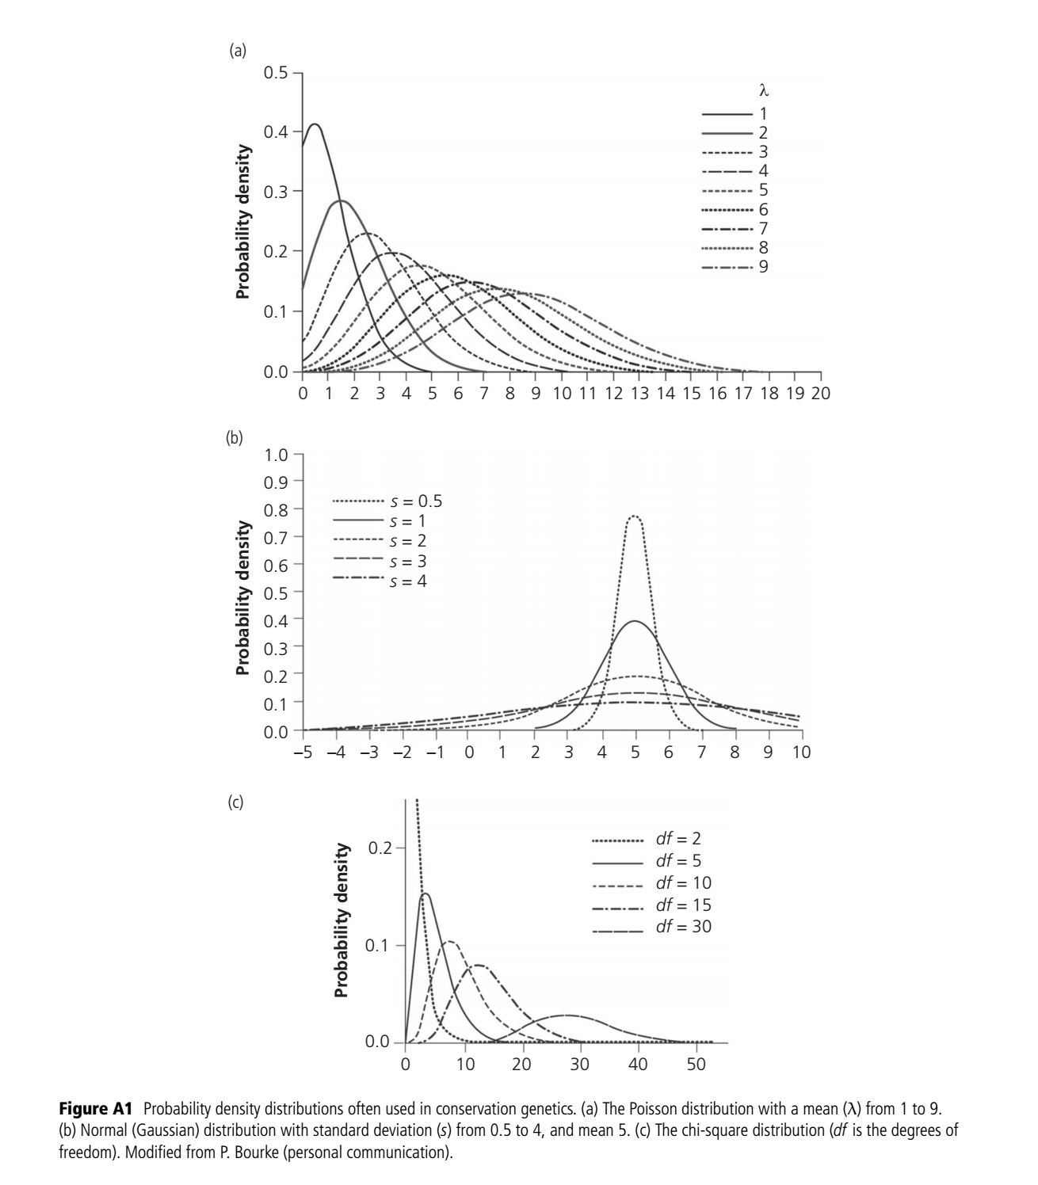
Probability Distributions
https://www.rpubs.com/jpv7311/DDP
https://bcdudek.net/stdnormal/
https://bcdudek.net/chisq/

Slide 20
Probability Distributions
https://www.rpubs.com/jpv7311/DDP
https://bcdudek.net/stdnormal/
https://bcdudek.net/chisq/

Slide 21
Frequentist Approach
Stating a hypothesis
Collecting data
Computing a summary statistic
Test hypothesis
Test/infer how frequently we would observe our data by chance alone if the NULL hypothesis was true

Slide 22
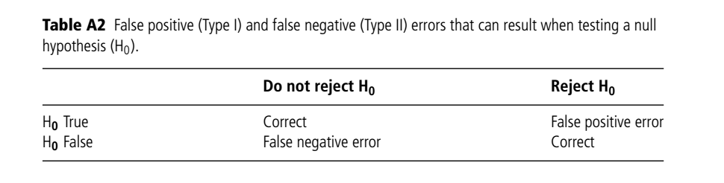
Frequentist hypothesis testing, statistical errors, and power

Slide 23
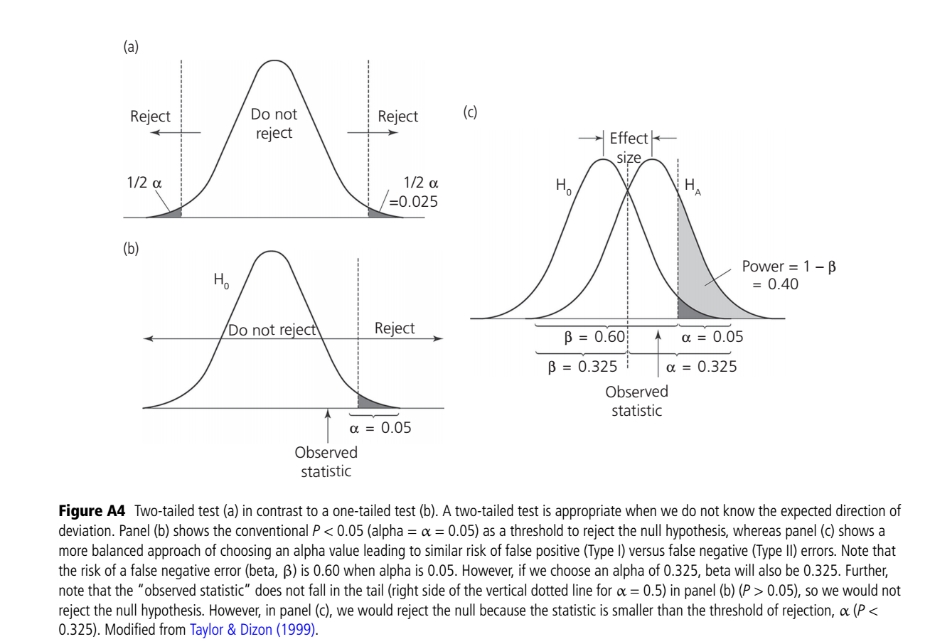
Frequentist hypothesis testing, statistical errors, and power

Slide 24
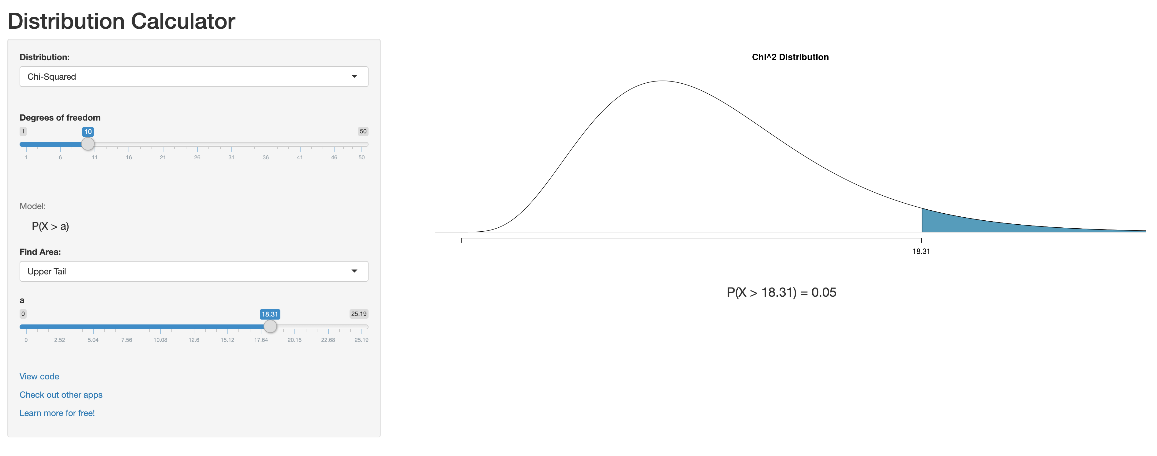
Probability Distributions for tests!
https://gallery.shinyapps.io/dist_calc/

Slide 25
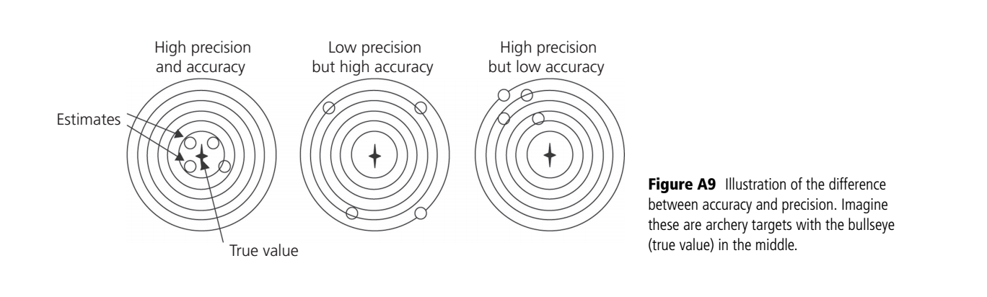
Frequentist hypothesis testing, statistical errors, and power
Precision- repeated estimates give similar results
Accuracy of an estimator is its tendency to yield estimates near the true population parameter value.

Slide 26
Maximum Likelihood Approach
Collecting data
Developing a mathematical model with parameters
Inputting raw data into the model
Computing the likelihood of the data for all possible parameter values
https://www.youtube.com/watch?v=93fPFOf547Q

Slide 27
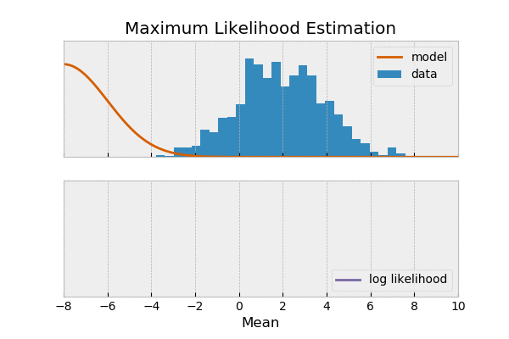
Maximum Likelihood Approach

Slide 28
Bayesian Approach
In can incorporate prior information to compute a probability estimate
It directly yields the probability of the hypothesis being true
Posterior Probability

Slide 29

Bayesian Approach
$$P\left(A | B\right)= \frac{P\left(B|A\right)∗P\left(A\right)}{P\left(B\right)}$$

Slide 30

Bayesian Approach
$$P\left(H | E\right)= \frac{P\left(E|H\right)∗P\left(H\right)}{P\left(E\right)}$$
https://www.youtube.com/watch?v=HZGCoVF3YvM&t=73s

Slide 31
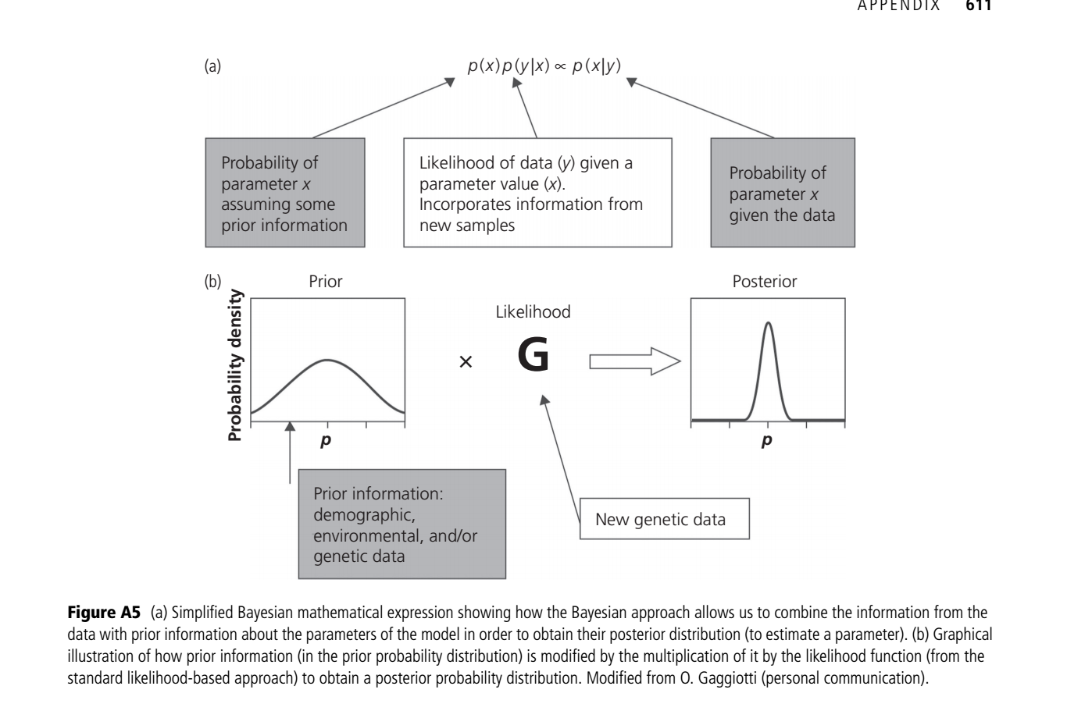
Bayesian Approach

Slide 32
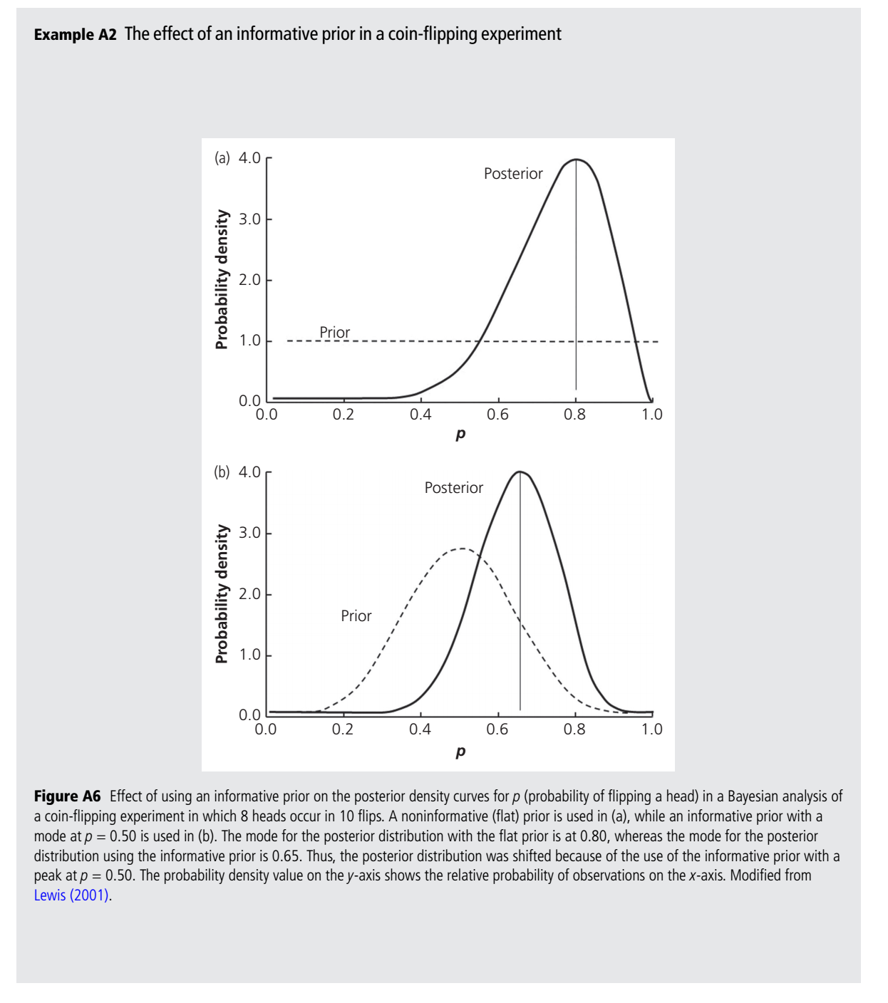
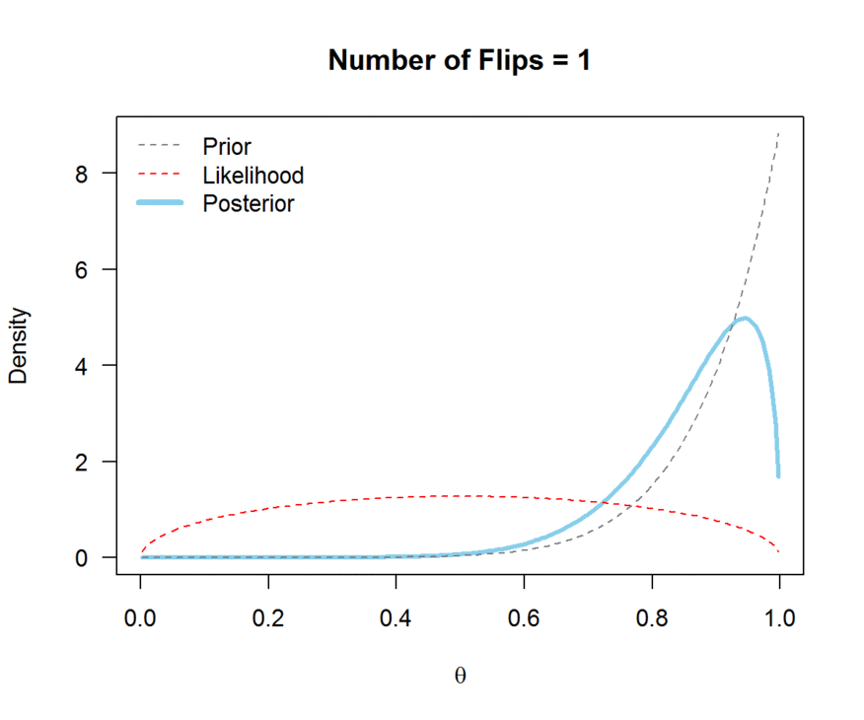
Bayesian Approach

